Slide 1

Analysis of the 5G Smartphone Market in India’s Mobile Phone Industry using Python
BY
BAMISAYE PIOUS ALEXANDER
GIVEN BY:

Slide 2
INTRODUCTION
The rise of 5G technology is reshaping India's mobile phone industry, driving demand for 5G enabled smartphones across different price segment. As telecom providers expands coverage, smartphone brands compete to attract customers with advanced features and competitive prices.
This projects analyses India’s 5G smartphone market using python, focusing on brand influence, pricing trends, customer preferences, and hardware specifications. Using Pandas, NumPy, Matplotlib, and seaborn, the study explores key insights through correlation analysis and market share distribution
The findings will help manufacturers, telecom providers, and policymakers make data-driven decisions in evolving 5g landscape.

Slide 3
DATASET OVERVIEW
The dataset used for this project was scrapped from MySmartPrice (mysmartprice.com), a popular India website that provides information on mobile phone specifications, prices and comparisons of mobile phones in India. It contains 959 rows and 10 columns representing different 5G smartphone models and their key specification.
This datasets includes the following columns:
Model: The name of the smartphone model.
Brand: The manufacturer of the smartphone.
Screen Size:The display size of the smartphone in inches.
Front Camera: The resolution of the front-facing camera.
Back Camera: The resolution of the rear camera(s).
Battery Capacity: The battery capacity in mAh.
ROM: The internal storage capacity of the device.
RAM: The amount of random-access memory in the device.
Clock Speed: The speed of the device’s processor in GHz.
Price: The price of the smartphone in Indian Rupees (INR).

Slide 4
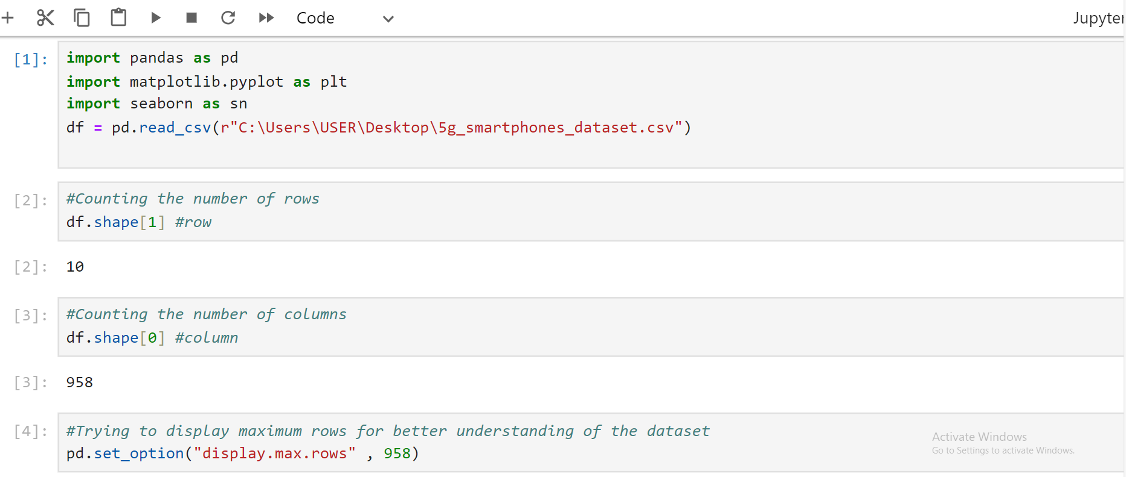
DATA CLEANING
Data cleaning is a vital process that ensures data accuracy and consistency for effective analysis.

Slide 5
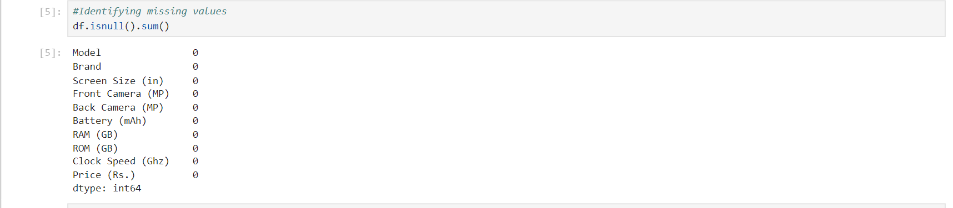
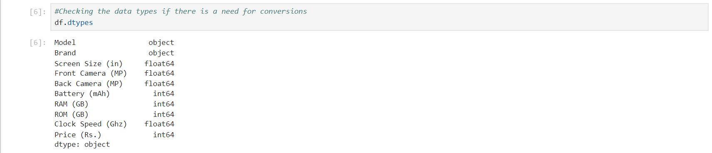
STEP TAKEN IN DATA CLEANING
Identifying Missing values and determined whether to fill or remove values based on their impact on analysis.
Checking data types of each column and converted if necessary.

Slide 6
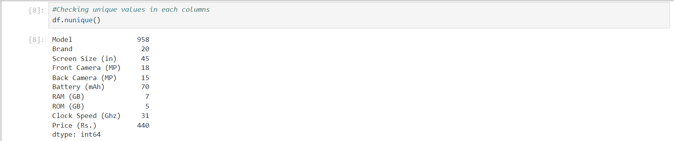
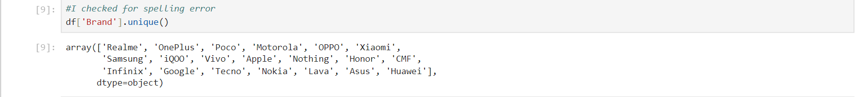
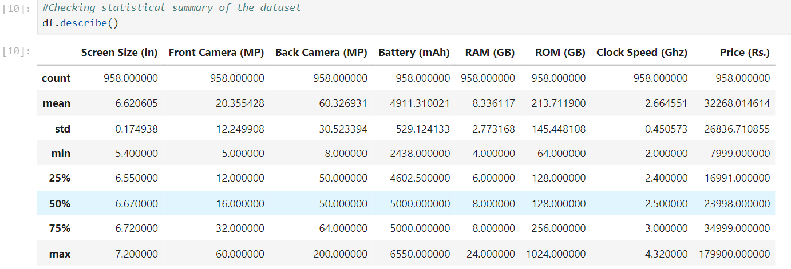
Detecting and removing duplicates if needed to maintain data integrity.
Checking unique values of each column to detect spelling errors.
Performing statistical summary analysis to identify potential anomalies in numerical values.

Slide 7
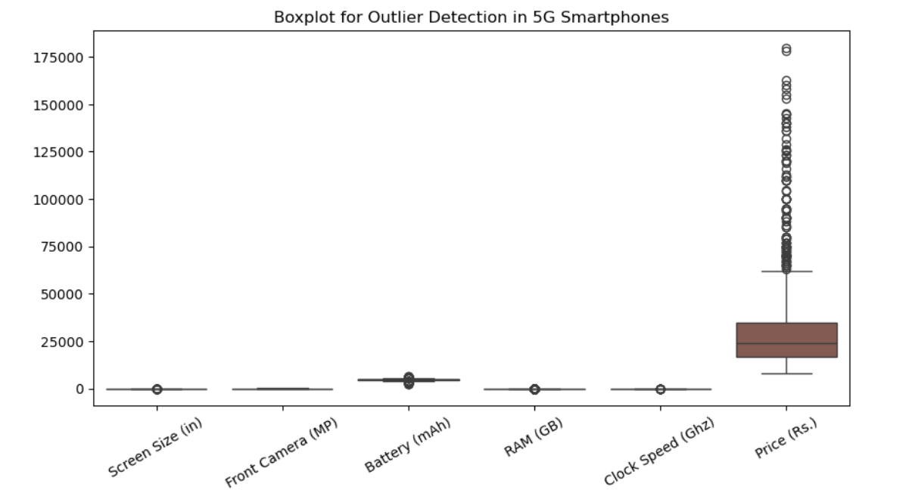
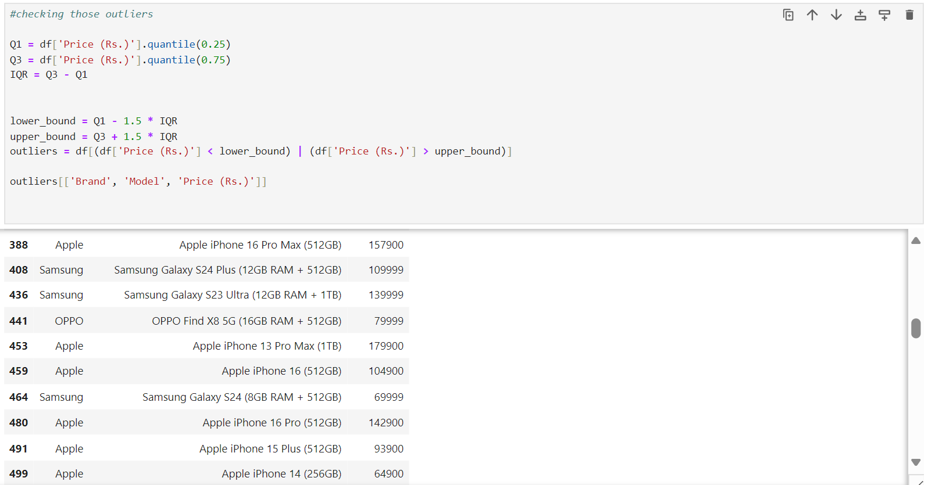
Detecting outliers that may need correction, removal or further investigation before analysis.(Apple and Samsung often have high premium pricing due to their brand known innovation , quality and prestigue. So I believe they are valid data point not statistical error.

Slide 8
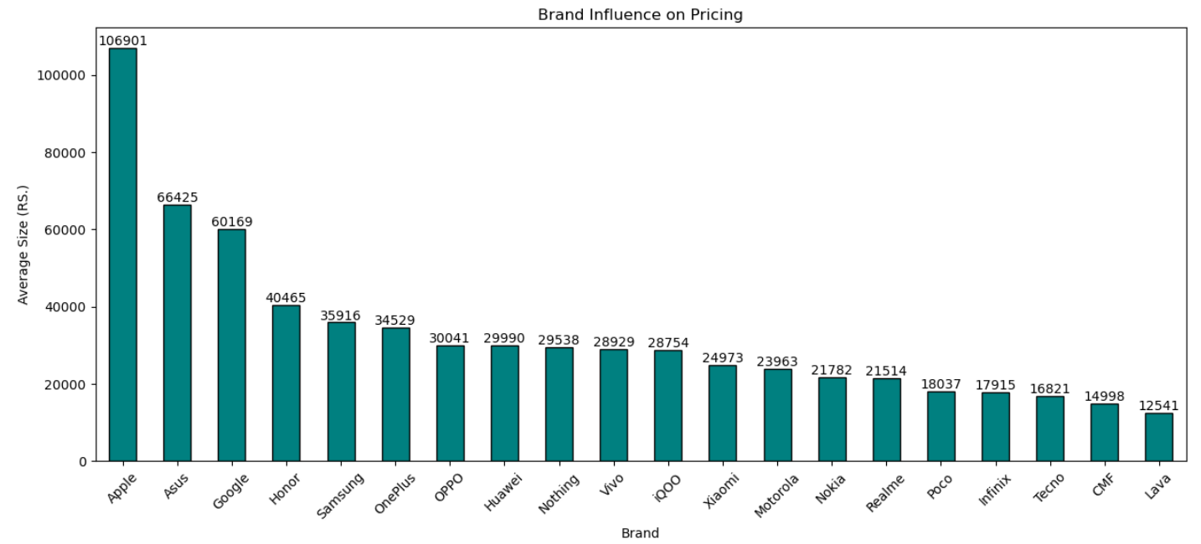
RESULT FINDINGS
After conducting data cleaning and exploratory data analysis, several insights were derived from the dataset. The analysis focused on understanding brand influence, pricing trends, customer preferences, and hardware specifications.
BRAND PRICING TRENDS:
A bar chart was created to visualize the average price of 5G smartphones by brand. The analysis revealed significant price differences, identifying premium, mid range and budget segments.
Key Insight: Apple’s 5G smartphones are the most expensive while Lava’s are the cheapest. Brand popularity drives big price gaps, from luxury to affordable options.

Slide 9
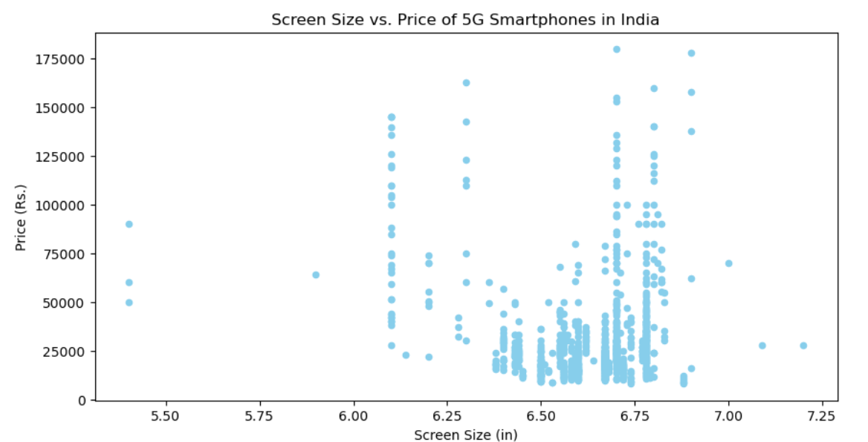
SCREEN SIZE VS PRICE OF 5G SMARTPHONES IN INDIA:
A scatter plot was created to visualize the relationship between screen size(in inches) and price(in Indian Rupees, Rs.) of 5G smartphone in India.
Key insights
No strong Correlation: The points are widely scattered indicating that screen size does not have a clear linear relationship with price. (Larger screens do not always means higher prices)
Most smartphones have screen sizes between 6.0 to 6.8 inches, but their prices range significantly, from low budget to premium models.

Slide 10
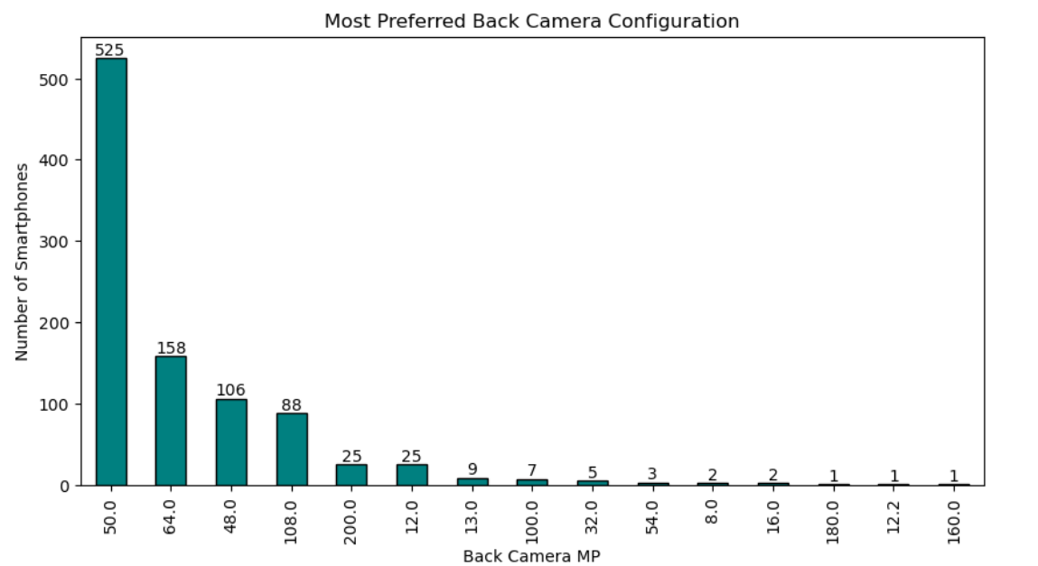
MOST PREFERRED BACK CAMERA CONFIGURATION:
A bar chart was created to visualize the distribution of smartphone preferences based on back camera megapixel (MP) configurations.
Key insights : The market favors 50MP cameras, with 64MP and 48MP also being widely used. Ultra high MP configurations (160MP and above) remain niche, possibly due to cost or diminishing returns in real-world performance.

Slide 11
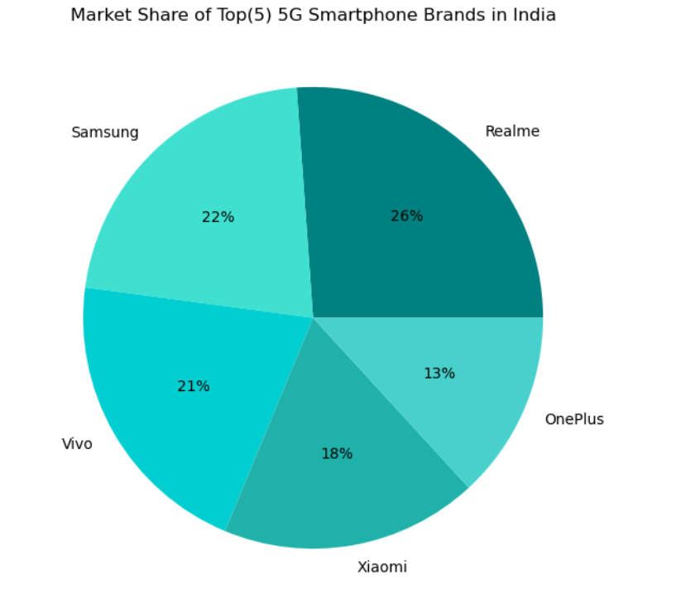
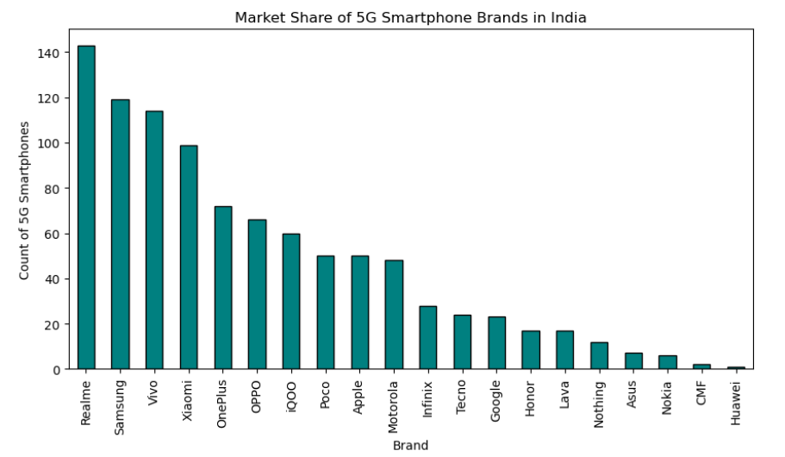
MARKET SHARE OF TOP (5) 5G SMARTPHONE BRANDS IN INDIA:
A pie chart was created to visualize the market share distribution of the top(5) 5G smartphone brands in India.
Key insight: Realme dominated suggesting strong demand for its 5G smartphones, while Samsung, vivo, and xiaomi maintain strong competition.
However, when considering all brands (as seen in the bar chart), Huawei has the smallest market share over all.

Slide 12
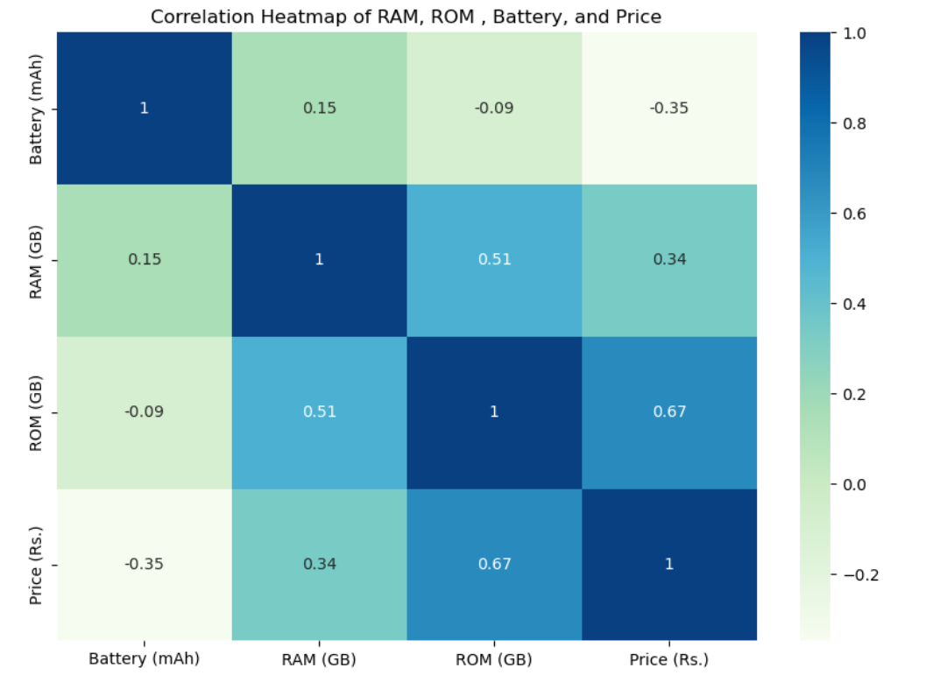
Correlation heatmap of RAM, ROM, Battery, Price:
A correlation heatmap was used to analyze the relationship between screen size, RAM, ROM, battery capacity and price of 5G smartphone in India.
Key insights: Storage(ROM) plays the most significant role in determining the price of 5G smartphones in India, while battery capacity has little to no impact on pricing. High RAM and ROM combinations are common in premium devices.

Slide 13
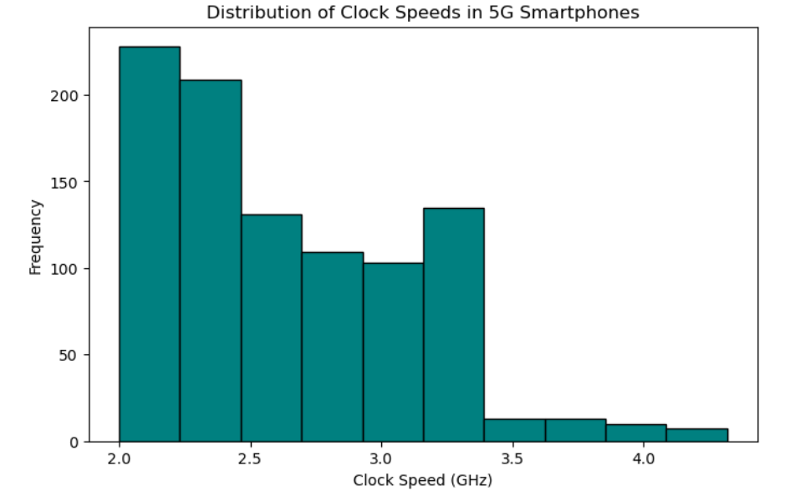
SCREEN SIZE VS PRICE OF 5G SMARTPHONES IN INDIA:
A bar chart was created to visualize the distribution of clock speeds in 5G smartphones.
Key insight: Most 5G smartphones in India operate within the 2.0 – 2.5 GHz range, balancing performance and power efficiency. Higher clock speeds are less common, mainly seen in premium flagship models.

Slide 14
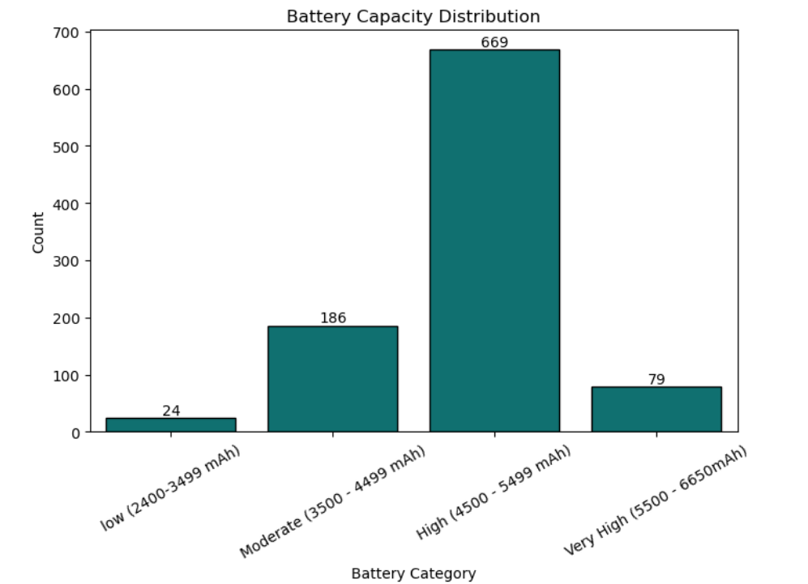
BATTERY CAPACITY DISTRIBUTION:
A bar chart was created to provides an analysis of how battery capacities vary across 5G smartphones in India.
Key insight: Most 5G smartphones in India feature battery capacities between 4500- 5499 mAh, ensuring longer usage times. Devices with very high battery capacities(5500 – 6500 mAh) are less common, likely due to trade- offs with weight and size.

Slide 15
RECOMMENDATION
Based on the insights derived from the analysis, the following recommendations are proposed for manufacturers, telecom providers, and policymakers to enhance the growth and competitiveness of India’s 5G smartphone market
Strengthen Realme’s dominance while brands like Huawei should improve their market strategy.
Offer high ROM options, as storage plays a key role in pricing, while balancing processor speed for efficiency.
Instead of larger batteries, optimize Power management for longer usage or improve batteries efficiency rather than just increasing capacity, as larger batteries add weight and size.
Expand affordable 5G smartphone options to attract price-sensitive buyers.
Improve marketing strategies for niche high – MP camera models(160MP and above) to create a stronger value proposition for premium buyers
Improve camera technology in mid-range models by focusing on 50MP and 64MP sensors, which are the most popular choices among customers.

Slide 16
CONCLUSION
The Indian 5G smartphone market is highly competitive, with Realme leading and Huawei holding the smallest share. Storage (ROM) impacts pricing the most, while battery capacity has minimal influence. Most devices operate within 2.0 – 2.5 GHz and feature 4500 – 5499 (mAh) batteries. To stay ahead, brands should focus on affordable 5G models, optimize storage options, and balance performance with efficiency.

